Slide 1

ScanMasterX Team No 10: UwUltimate Stardust Crusaders

Slide 2





Team Details
Dennis
Eric
Lewis
Alexa
Will

Slide 3
Problem Statement

Slide 4
Project Overview
ScanMasterX seeks to lower the barrier of entry to analyzing and understanding the security of a network.
Scans for IP addresses within a network
Scans the ports located at specified IP addresses
Displays the topology of the IP addresses found on a network
Attempts a simple exploit

Slide 5
Requirements List
There must be a feature to identify vulnerabilities on a server.
There must be a component that will evaluate the security of the ports on a given server.
The user must be able to select which device(s), which ports, or which group of ports, that they wish to test and scan.

Slide 6
Project Solution Approach
Major Components
Custom scanner leveraging Nmap
GUI for user to interact with
Tools, Frameworks, Platforms, Libraries
PYQT - UI framework for Python
NMAP – A CLI network scanner
CVE Database [TBD]

Slide 7
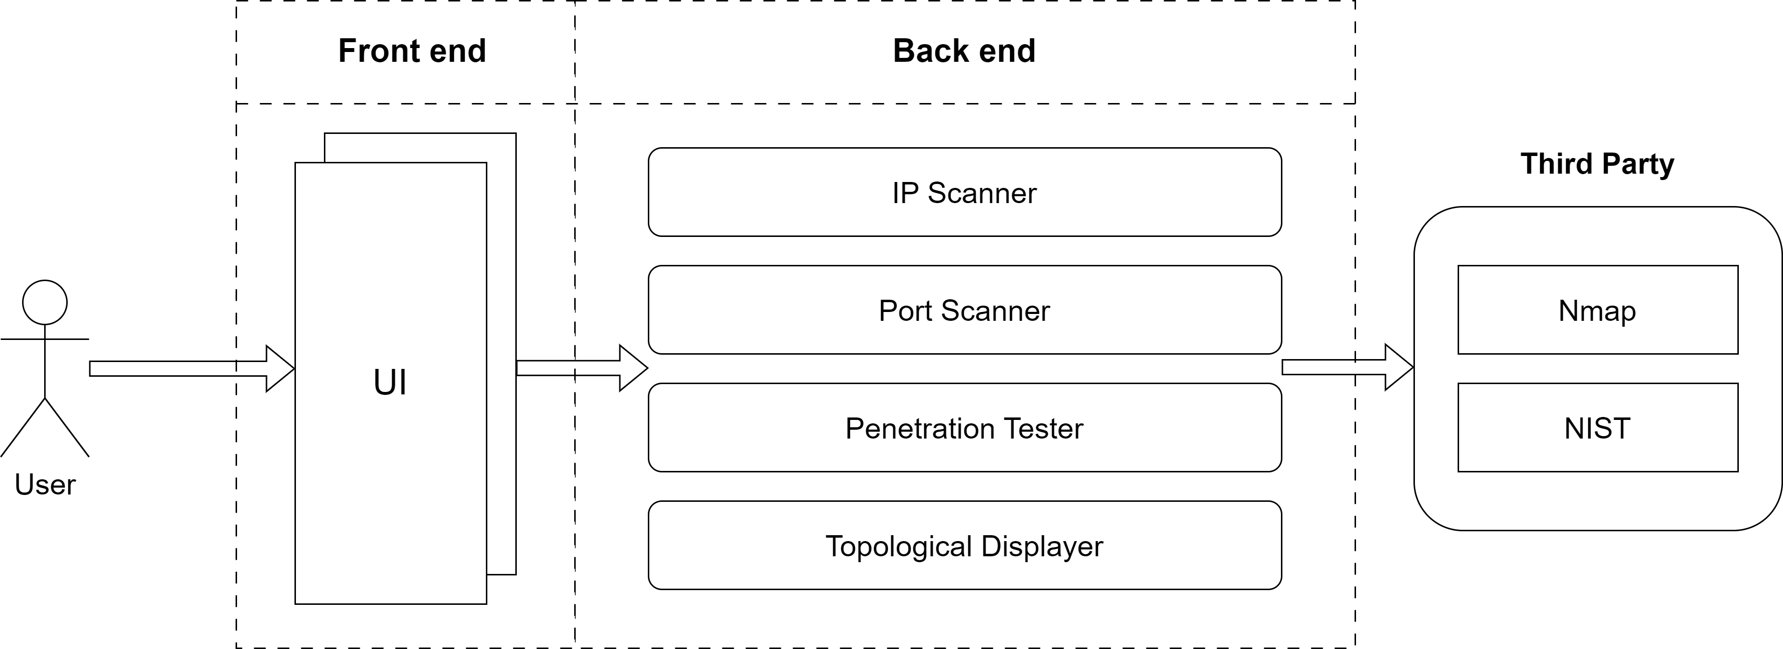
System Architecture Diagram

Slide 8
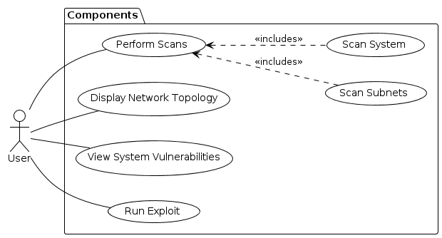
Use Case Modeling

Slide 9
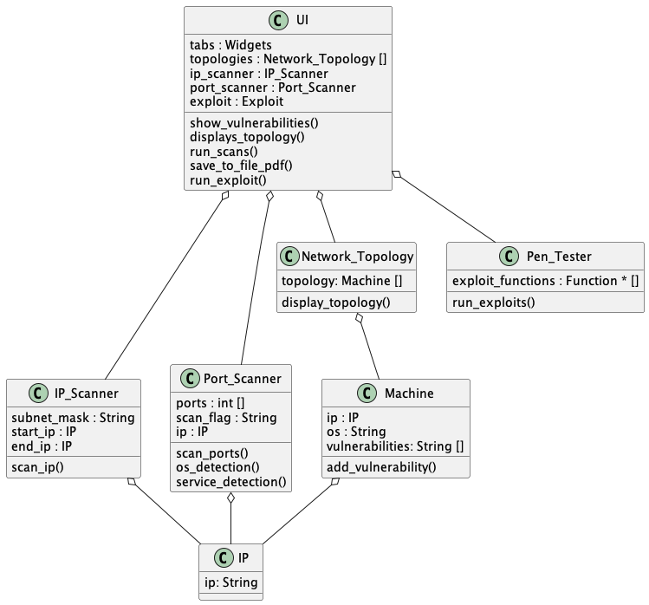
Structural Modeling: Class Diagram

Slide 10
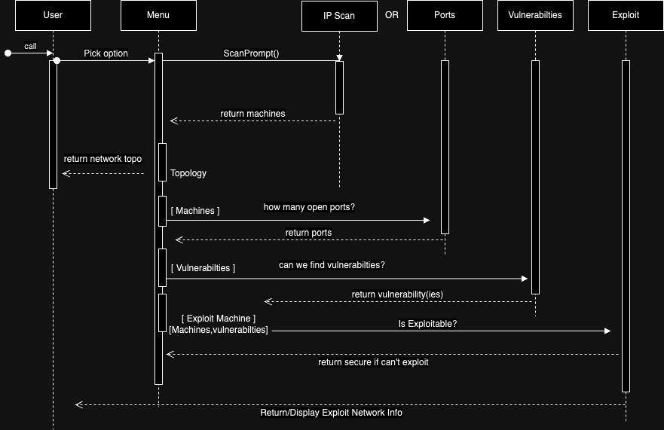
Behavioral Modeling: Sequence Diagram

Slide 11
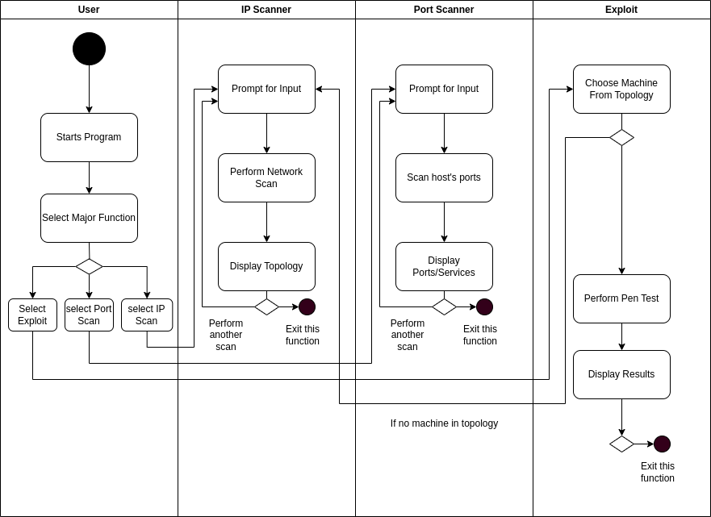
Behavioral Modeling: Activity Diagram

Slide 12
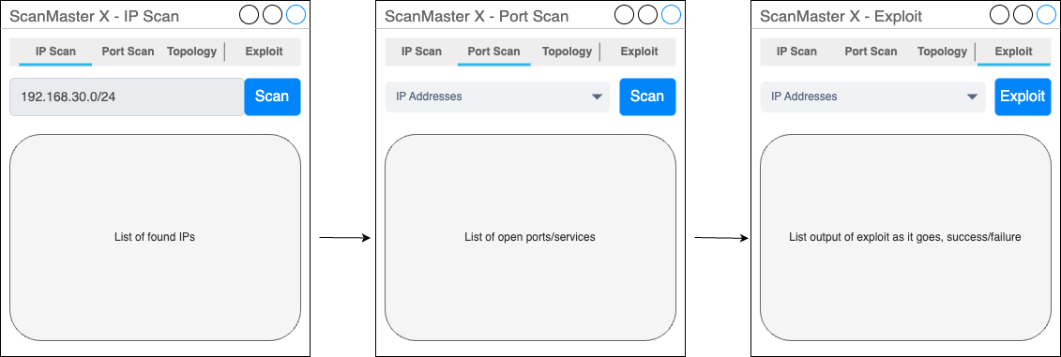
Screenshots (UI, Code, if any)

Slide 13
ftp code comment out comments – don’t include the class

Slide 14
What’s Next??
Development of the UI using PYQT6
Finishing Class
Create endpoints for testing

